Slide 1
Criminological Perspective to Cybersecurity

Slide 2
Decisions/Behavior?
You
Criminals?
Victims?
Organizations?

Slide 3
Traditional Crime Prevention?
Laws
Deterrence
Computer Fraud and Abuse Act
WPAFB

Slide 4
Computer Fraud and Abuse Act
Inflicting damage to a protected computer
“affects interstate or foreign commerce or communication of the US”
Felony
10 years (maximum) + fine
20 years for subsequent counts
Misdemeanor
1 year (maximum) + fine
10 years for subsequent counts
Even threats and/or attempts illegal

Slide 5
Computer Fraud and Abuse Act
Intentional Conduct
Knowingly transmitting a “program, information, code, or command” resulting in “damage” to a “protected computer”
Reckless Conduct
Intentional unauthorized access causing damage
Outsiders only
Negligent Conduct
Unauthorized access causing damage
Outsiders only
Misdemeanor

Slide 6
Cybercrime Cases
Mitchell Frost – University of Akron
Website defacement/DOS
30 Months Prison
Chris Correa
Cardinals Front Office
48 Months Prison (2 draft picks, $2 million)
Danielle Duann – Organ Donation Center
Disgruntled IT Manager
Deleted files
24 Months Prison
cybercrime.gov

Slide 7
Law Enforcement
FBI/Infragard
fbi.gov/investigate/cyber infragard.net
DHS - CERT
us-cert.gov
DOJ - CCHIPS
justice.gov/criminal/cybercrime/
Secret Service – ECTF
secretservice.gov
Internet Crime Complaint Center
ic3.gov

Slide 8
Cybercrime Reporting/Prosecution
High percentage?
Why?
Bad publicity
Lose control, waste time
Jurisdiction (domestic or international)
Anonymity
Not always required

Slide 9
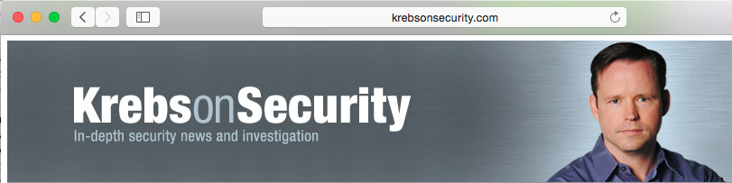

Slide 10
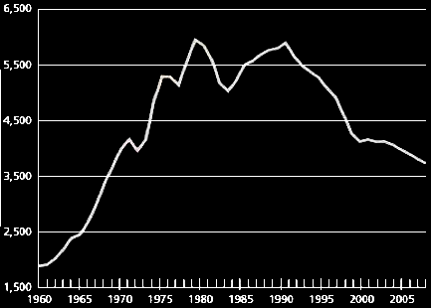
US crime rate per 100k

Slide 11
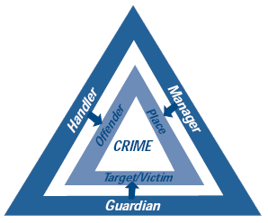
Crime Science
Routine activity theory
Rational Choice/Behavioral Economics
Opportunity -> Crime
Cohen & Felson
Eck
Situational crime prevention

Slide 12
Situational Crime Prevention

Slide 13
US crime rate per 100k

Slide 14
“I’ve never had the need, skillset, or knowledge”
“Number 1 it is wrong. Number 2 I would have no idea where to start”
“Been too busy to learn”
Stockman, Holt, Mackey, & Holiday, 2013 Cyberdeviance Study
Notes:
Study when I thought offenders mattered
These your future employees

Slide 15
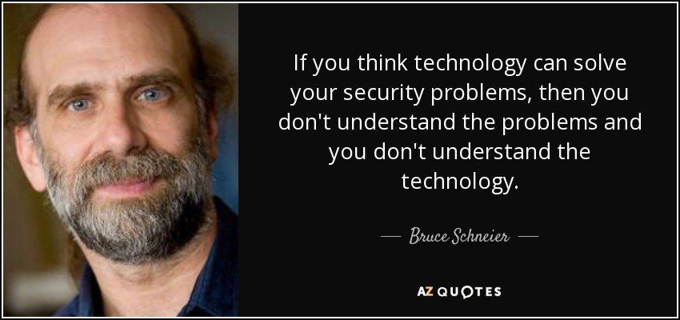

Slide 16
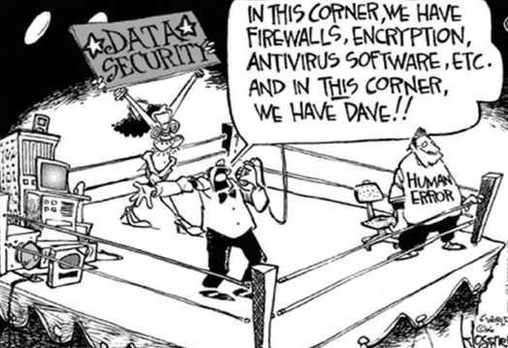
Organizational Cybervictimization
Organizational decisions
Non-malicious employee behavior

Slide 17
Why not follow best practice?
Incentive structure
Individual characteristics
Notes:
Maybe you are ok, but your supply chain? Shadow IT?
Hypothesis based on crime prevention literature.

Slide 18

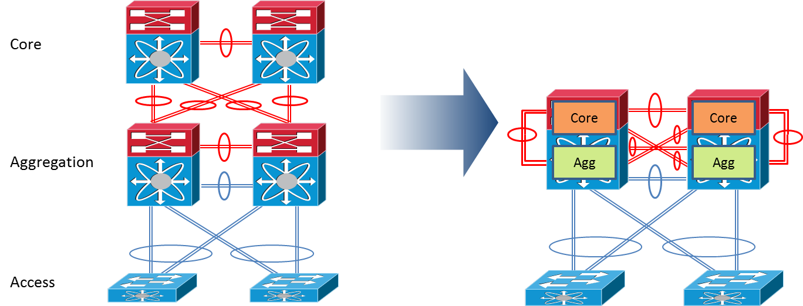


t
Notes:
Experian too, lack of attention on cyber after acquisitions

Slide 19
Pew Pew Maps

Slide 25
